Slide 1
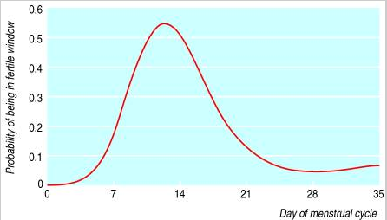
AI HEALTHCARE HACKATHON
FERTILITY PREDICTION
2019 MARCH 30

Slide 2
Challenge Statement
Using AI, predict when an upcoming period will most likely start next for a given female user, helping women to predict fertile window and predict symptoms and correlations.
Background and dataset: http://bit.ly/2Wszlba

Slide 3





MEET CHERYL
Cheryl is 40 and has been married for 2 years
She loves art and has been growing her design business for the past 5 years
She volunteers in the community to help build playgrounds for children
She has been trying to get pregnant for the past 10 months

Slide 4

Problem: Maximizing Timing to Create a Family
The Struggle Over 40
Women 40 and over have a 30% chance of infertility
A 40 year old only has a 5% chance to get pregnant
Average probability for fertility
Menstrual
Cycle
60% best case
55% when missed by 1 day
30% when missed by 1 week
https://www.ncbi.nlm.nih.gov/pmc/articles/PMC3767864/ https://academic.oup.com/humrep/article/14/7/1835/2913179#66880279

Slide 5
Pregnancy: A Major Medical Cost
$1 Billion Out of Pocket Annual Expenditures on Fertility Treatments 86,000 cycles
X
Average Cost of $12,400 per cycle**
86,000 Assisted Reproductive Therapy Cycles
23,000 Pregnancies
4 Million unable to conceive after 12 months consecutively
7 Million Women Perform Fertility Tests Annually
**This is whether the cycle is successful or unsuccessful. For most people, they require multiple cycles.
https://www.cdc.gov/art/reports/2016/fertility-clinic.html

Slide 6
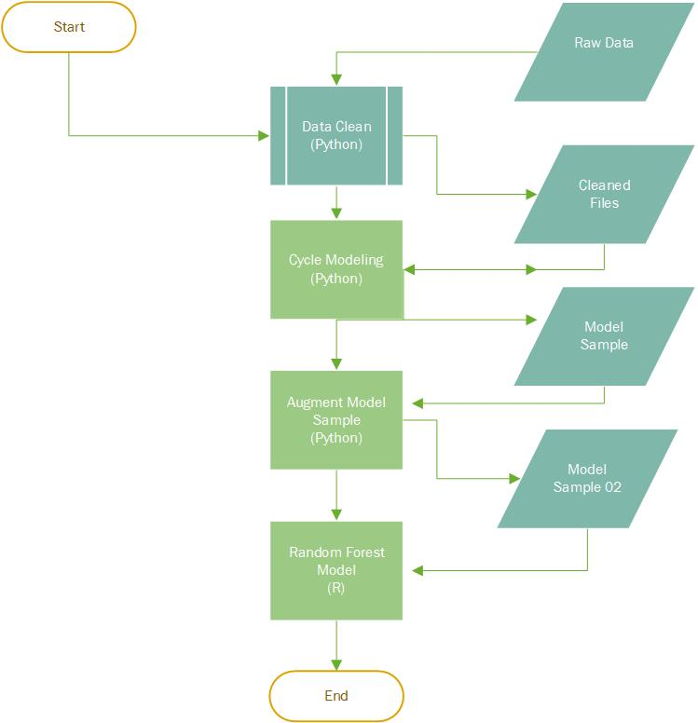
Solution: Process
Raw Data was cleaned and outliers removed
Removed negative cycle data
Removed future date data
Removed cycles over 45 days
Data was converted from period data to cycle length data
Cleaned data was divided into test and training data sets.
Using the RandomForest library in R, a model was trained and test values were predicted.

Slide 7
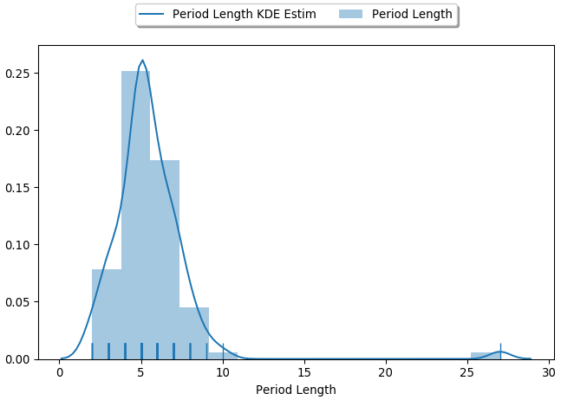

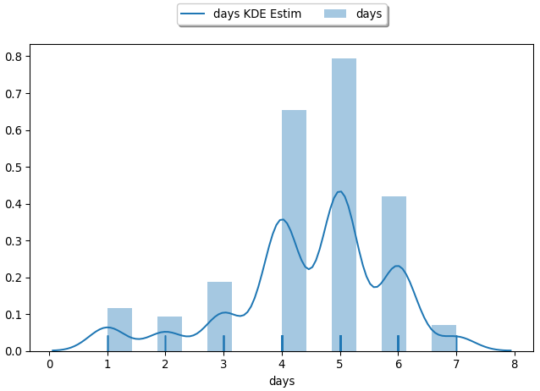
Solution: Results
Subjective
Naïve Analysis
average cycle length for the entire data set, resulted in a RMSE of 5.091453 days.
Random Forest Analysis
Objective
Reduced error to 4.511861 days; a 21.47% improvement

Slide 8



Adoption Strategy
#2 Medical Showcases
American Society of Reproductive Medicine
#1 Fertility Clinics
National Hospitals
Regional Hospitals
#3 Insurance Providers

Slide 9

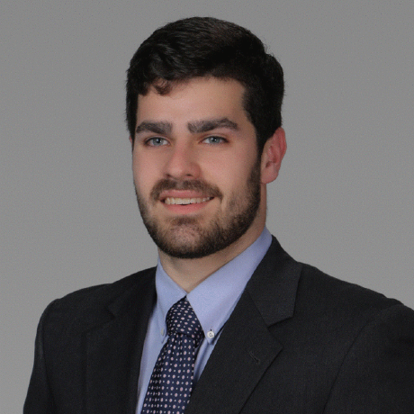
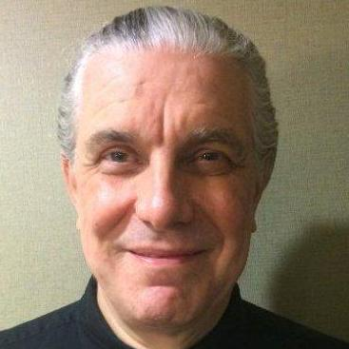

Team
Patrick Cronin
Bill Ulrich
George Zipperlen
Lester Chiu
Brad Bergling
Senior Manager, Accenture Technology
Python Trainer
Brilliant Scottish Data Scientist
Biomedical Engineer
Accenture Consulting Analyst

Slide 10
APPENDIX

Slide 11
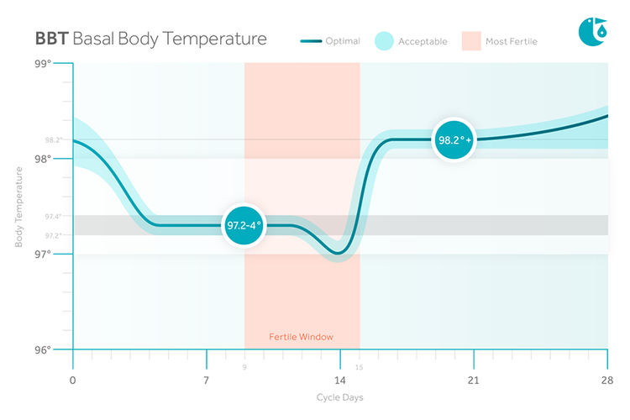
BASAL BODY TEMPERATURE VS FERTILITY
To improve future data efforts, wearable body temperature sensors can be used in conjunction with symptom recognition to determine fertility windows
Basal Body Temperature Info:
https://www.ncbi.nlm.nih.gov/pubmed/7308516

